Slide 1
RESEARCH WEBS
TOOLS - MANUFACTURING PROCESS and PRINTING PROCESSES
USING TECHNOLOGYSTUDENT.COM TO FIND INFORMATION
To help you ﬁnd the information you need, use the ‘search’ function at the bottom of any page of technologystudent.com. The majority of the answers will be found on this website.
For any other information, use a search engine such as Google.
HELPFUL TIP
When using the search function, at the bottom of each page of technologystudent.com, select this option.
WORLD ASSOCIATION OF TECHNOLOGY TEACHERS
https://www.facebook.com/groups/254963448192823/
www.technologystudent.com © 2020 V.Ryan © 2020

Slide 2
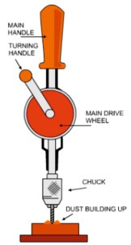
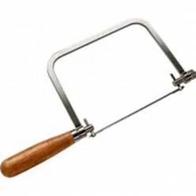
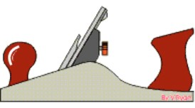
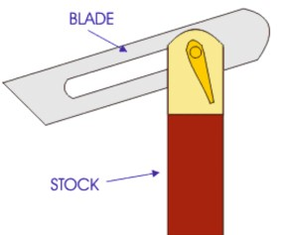
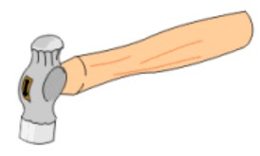
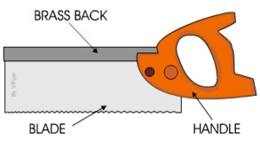
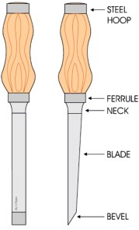
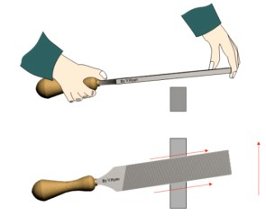
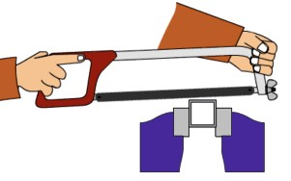
REVISION WEB - TOOLS
WORLD ASSOCIATION OF TECHNOLOGY TEACHERS https://www.facebook.com/groups/254963448192823/ www.technologystudent.com © 2017 V.Ryan © 2017
RESEARCH EACH OF THE TOOLS / EQUIPMENT AND WRITE FACTS ON THE REVISION WEB. ADD A SMALL IMAGE(S) FOR EACH OF THE TOOLS / EQUIPMENT. AN EXAMPLE HAS BEEN COMPLETED FOR YOU.
HAND DRILL
COPING SAW
PREPARING A LENGTH OF WOO_{D}
FOR LEVELLING A SURFACE
SMOOTHING WOOD
SMOOTHING PLANE
FACE SIDE / FACE EDGE
SLIDING BEVEL
BALL PEIN HAMMER
TENON SAW
HACKSAW
CHISELS
HAND FILE

Slide 3
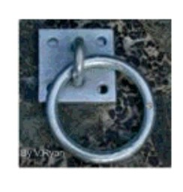
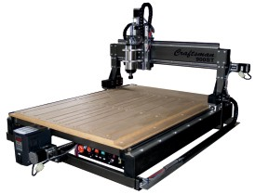
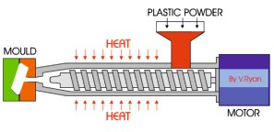
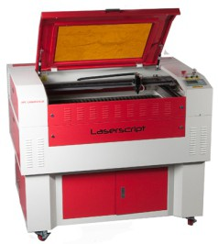
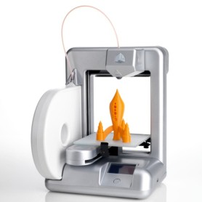
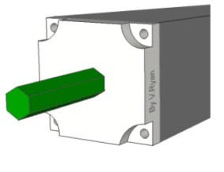
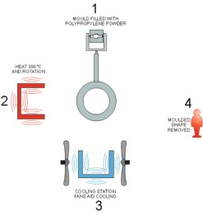
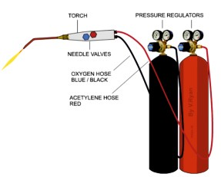
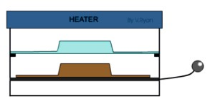
REVISION WEB - MANUFACTURING PROCESSES
WORLD ASSOCIATION OF TECHNOLOGY TEACHERS https://www.facebook.com/groups/254963448192823/ www.technologystudent.com © 2017 V.Ryan © 2017
RESEARCH EACH OF THE MANUFACTURING PROCESSES. WRITE FACTS ON THE REVISION WEB. YOU CAN ADD A SMALL IMAGE(S) FOR EACH OF THE PROCESSES. AN EXAMPLE HAS BEEN COMPLETED FOR YOU.
GALVANISING STEEL
MANUFACTURE
CNC ROUTER
CAM - COMPUTER AIDED
CONTROLLED BY COMPUTER
LINKS TO CAD SOFTWARE
CUTS ACCURATE SHAPES
USUALLY IN ‘WOOD’
INJECTION MOULDING
LASER CUTTER
EXTRUSION
3D PRINTER
VACUUM FORMING
ROTATIONAL MOULDING
OXYACETYLENE WELDING

Slide 4
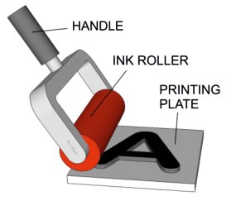
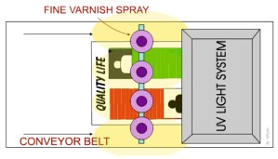
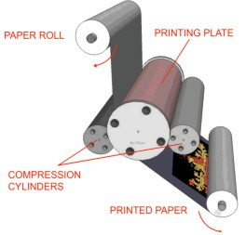
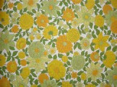
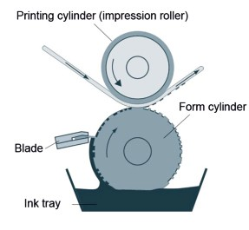
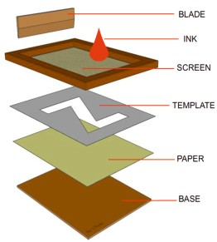
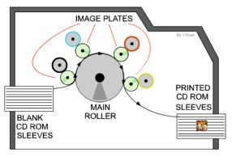
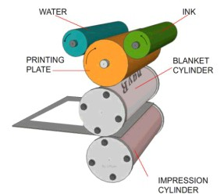
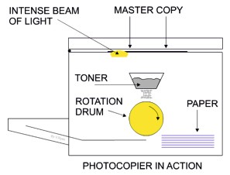
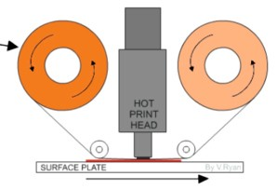
REVISION WEB - PRINTING PROCESSES
WORLD ASSOCIATION OF TECHNOLOGY TEACHERS https://www.facebook.com/groups/254963448192823/ www.technologystudent.com © 2017 V.Ryan © 2017
RESEARCH EACH OF THE PRINTING PROCESSES. WRITE FACTS ON THE REVISION WEB. CONSIDER ADDING AN IMAGE(S). AN EXAMPLE HAS BEEN COMPLETED FOR YOU.
LETTER PRESS
VARNISHING UV VARNISHING
WALLPAPER
COMMERCIAL PRINTING
FAST WHEN VOLUME PRINTING
PAPER PRODUCTS SUCH AS
ROTARY PRESS
WALLPAPER AND FABRICS
GRAVURE
DIRECT PRINTING
SCREEN PRINTING
FOIL BLOCKING / FOIL STAMPING
PHOTOCOPYING
LITHOGRAPHY

